Slide 1
Chapter 4: Intermediate SQL

Slide 2
Chapter 4: Intermediate SQL
4.1 Join Expressions
4.2 Views
4.3 Transactions
4.4 Integrity Constraints
4.5 SQL Data Types and Schemas
4.6 Authorization
Notes:
1

Slide 3
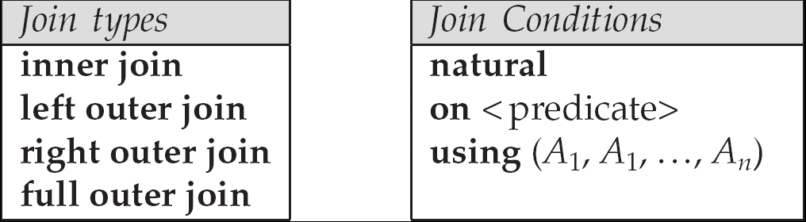
4.1 Joined Relations
Join operations take two relations and return as a result another relation.
These additional operations are typically used as subquery expressions in the from clause
Join condition – defines which tuples in the two relations match, and what attributes are present in the result of the join.
Join type – defines how tuples in each relation that do not match any tuple in the other relation (based on the join condition) are treated.

Slide 4
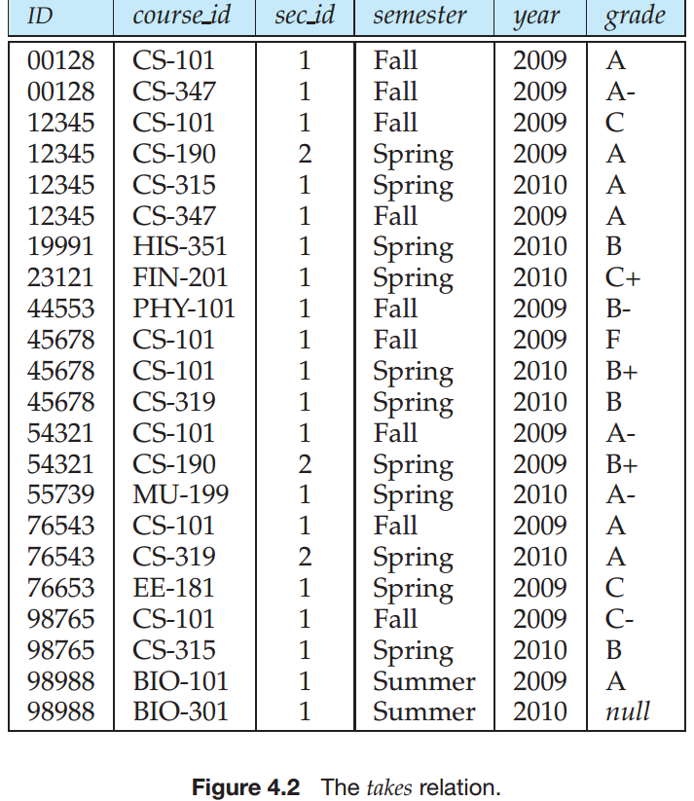
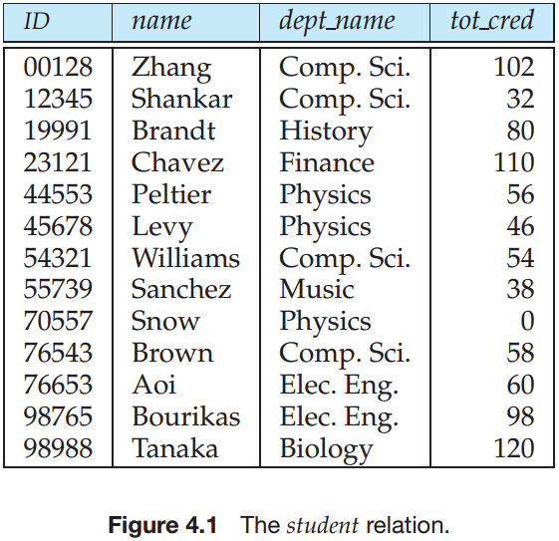
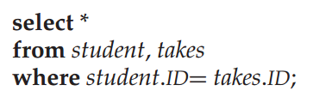

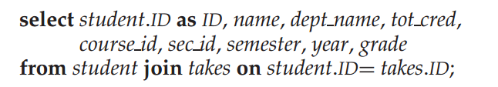

Slide 5
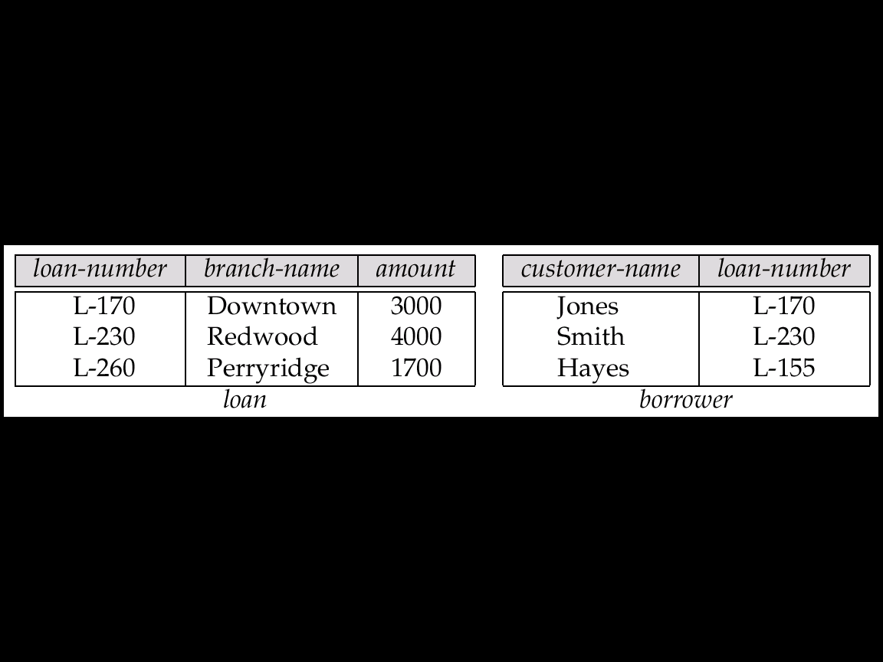
Fig. 4.1 The loan and borrower Relations
Joined Relations: Example (Datasets)

Slide 6
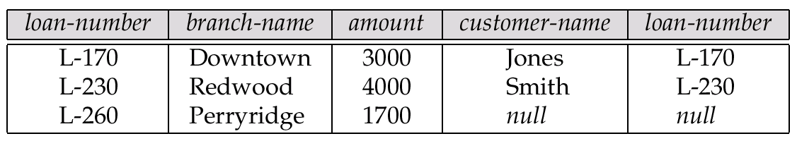
Fig. 4.2 The Result of loan inner join borrower on loan.loan-number = borrower.loan-number
Example: inner join
内连接基本与自然连接相同，不同之处在于自然连接要求是同名属性列的比较，而内连接则不要求两属性列同名，可以用using或on来指定某两列字段相同的连接条件。
丢弃

Slide 7
Fig. 4.3 The Result of loan left outer join borrower on loan-number
Example: left outer join
左外连接是在两表进行自然连接，只把左表要舍弃的保留在结果集中，右表对应的列上填null。

Slide 8
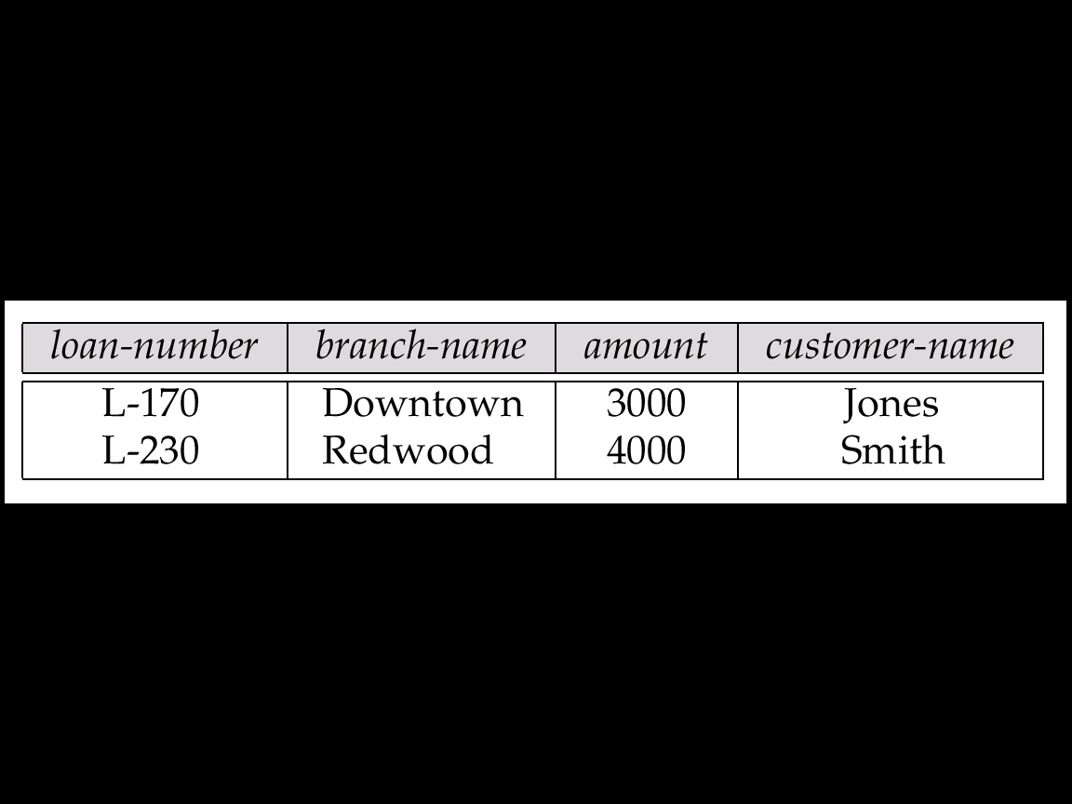
Fig. 4.4 The Result of loan natural inner join borrower
Example: natural inner join
自然连接是一种特殊的等值连接，他要求两个关系表中进行比较的必须是相同的属性列，无须添加连接条件，并且在结果中消除重复的属性列。

Slide 9
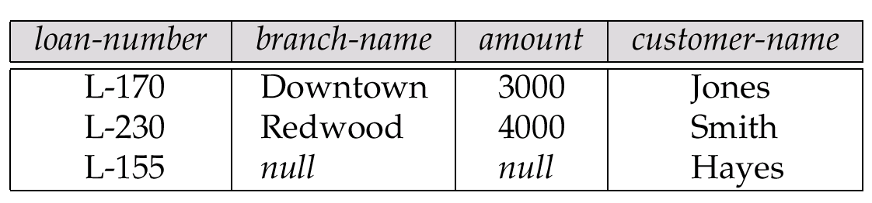
Fig. 4.6 The Result of loan natural right outer join borrower
Example: natural right outer join
右外连接是在两表进行自然连接，只把右表要舍弃的保留在结果集中，左表对应的列上填null。

Slide 10
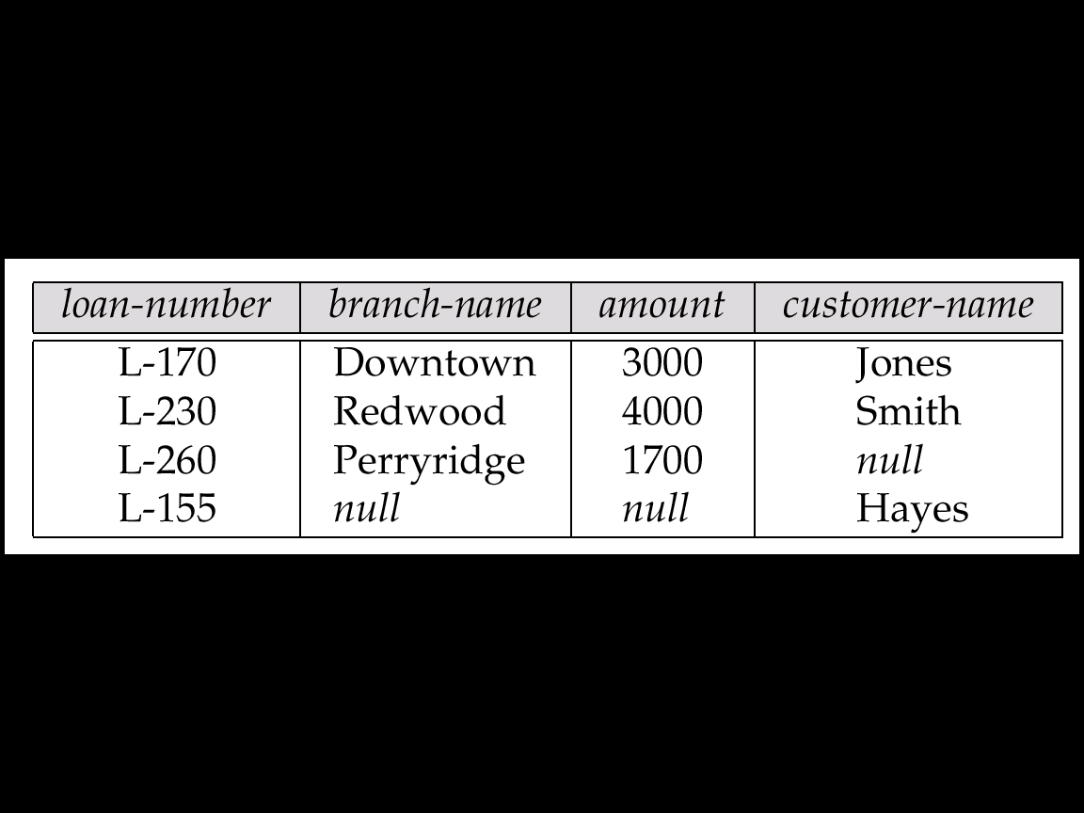
Fig. 4.7 The Result of loan full outer join borrower using (loan-number)
Example: full outer join
全外连接是在两表进行自然连接，只把左表和右表要舍弃的都保留在结果集中，相对应的列上填null。

Slide 11
4.2 Views
In some cases, it is not desirable for all users to see the entire logical model (that is, all the actual relations stored in the database.)
Consider a person who needs to know an instructors name and department, but not the salary. This person should see a relation described, in SQL, by select ID, name, dept_name from instructor
A view provides a mechanism to hide certain data from the view of certain users.
Any relation that is not of the conceptual model but is made visible to a user as a “virtual（虚拟的） relation” is called a view.

Slide 12
Views
Virtual table (doesn't really exist )
No stored file
Definition of view is stored in system catalog
A base table may be stored in several files
A file may contain several base tables
A view may be derived from several base tables
A base table may derive several views
SQL
View V1
View V2
Base
Table B1
Base
Table B2
Base
Table B3
Base
Table B4
Data Set
D1
Data Set
D2
Data Set
D3
Data Set
D4

Slide 13
View Definition
A view is defined using the create view statement which has the form
create view v as < query expression >
where <query expression> is any legal SQL expression. The view name is represented by v.
Once a view is defined, the view name can be used to refer to the virtual relation that the view generates.
View definition is not the same as creating a new relation by evaluating the query expression
Rather, a view definition causes the saving of an expression; the expression is substituted into queries using the view.

Slide 14
Example Views
A view of instructors without their salary create view faculty as select ID, name, dept_name from instructor
Find all instructors in the Biology department select name from faculty where dept_name = ‘Biology’
Create a view of department salary totals create view departments_total_salary(dept_name, total_salary) as select dept_name, sum (salary) from instructor group by dept_name;

Slide 15
Views Defined Using Other Views
create view physics_fall_2009 as select course.course_id, sec_id, building, room_number from course, section where course.course_id = section.course_id and course.dept_name = ’Physics’ and section.semester = ’Fall’ and section.year = ’2009’;
create view physics_fall_2009_watson as select course_id, room_number from physics_fall_2009 where building= ’Watson’;

Slide 16
Update of a View
Add a new tuple to faculty view which we defined earlier
insert into faculty values (’30765’, ’Green’, ’Music’);
This insertion must be represented by the insertion of the tuple
(’30765’, ’Green’, ’Music’, null)
into the instructor relation

Slide 17
Some Updates cannot be Translated Uniquely
create view instructor_info as select ID, name, building from instructor, department where instructor.dept_name= department.dept_name;
insert into instructor_info values (’69987’, ’White’, ’Taylor’);
which department, if multiple departments in Taylor?
what if no department is in Taylor?
Most SQL implementations allow updates only on simple views
The from clause has only one database relation.
The select clause contains only attribute names of the relation, and does not have any expressions, aggregates, or distinct specification.
Any attribute not listed in the select clause can be set to null
The query does not have a group by or having clause.

Slide 18
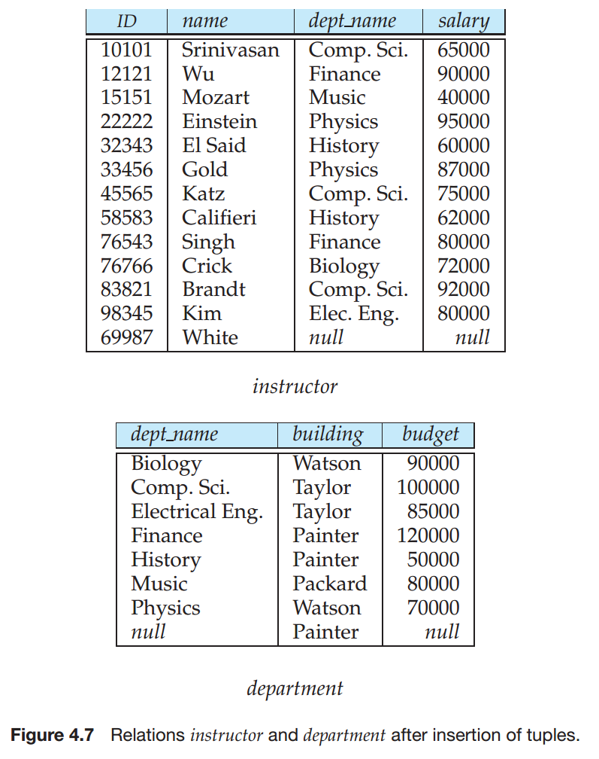

Slide 19
And Some Not at All
create view history_instructors as select * from instructor where dept_name= ’History’;
What happens if we insert (’25566’, ’Brown’, ’Biology’, 100000) into history_instructors?

Slide 20
Materialized Views
Materializing a view: create a physical table containing all the tuples in the result of the query defining the view
If relations used in the query are updated, the materialized view result becomes out of date
Need to maintain the view, by updating the view whenever the underlying relations are updated.

Slide 21
4.3 Transactions
Unit of work
Atomic transaction
either fully executed or rolled back as if it never occurred
Isolation from concurrent transactions
Transactions begin implicitly
Ended by commit work or rollback work
But default on most databases: each SQL statement commits automatically
Can turn off auto commit for a session (e.g. using API)
In SQL:1999, can use: begin atomic …. end
Not supported on most databases

Slide 22
4.4 Integrity Constraints
Integrity constraints guard against accidental damage to the database, by ensuring that authorized changes to the database do not result in a loss of data consistency.
A checking account must have a balance greater than $10,000.00
A salary of a bank employee must be at least $4.00 an hour
A customer must have a (non-null) phone number

Slide 23
Integrity Constraints on a Single Relation
not null
primary key
unique
check (P), where P is a predicate

Slide 24
Not Null and Unique Constraints
not null
Declare name and budget to be not null
name varchar(20) not null budget numeric(12,2) not null
unique ( A₁, A₂, …, A_{m})
The unique specification states that the attributes A1, A2, … Am form a candidate key.
Candidate keys are permitted to be null (in contrast to primary keys).

Slide 25
The check clause
check (P)
where P is a predicate
Example: ensure that semester is one of fall, winter, spring or summer:
create table section (
course_id varchar (8),
sec_id varchar (8),
semester varchar (6),
year numeric (4,0),
building varchar (15),
room_number varchar (7),
time slot id varchar (4),
primary key (course_id, sec_id, semester, year),
check (semester in (’Fall’, ’Winter’, ’Spring’, ’Summer’)) );

Slide 26
Referential Integrity
Ensures that a value that appears in one relation for a given set of attributes also appears for a certain set of attributes in another relation.
Example: If “Biology” is a department name appearing in one of the tuples in the instructor relation, then there exists a tuple in the department relation for “Biology”.
Let A be a set of attributes. Let R and S be two relations that contain attributes A and where A is the primary key of S. A is said to be a foreign key of R if for any values of A appearing in R these values also appear in S.

Slide 27
Cascading Actions in Referential Integrity
create table course ( course_id char(5) primary key, title varchar(20), dept_name varchar(20) references department )
create table course ( … dept_name varchar(20), foreign key (dept_name) references department on delete cascade（级联） on update cascade, . . . )
alternative actions to cascade: set null, set default

Slide 28
Integrity Constraint Violation During Transactions
E.g.
create table person ( ID char(10), name char(40), mother char(10), father char(10), primary key ID, foreign key spouse references person)
How to insert a tuple without causing constraint violation ?
Initially deferred(延期)

Slide 29
Assertion
An assertion is a predicate expressing a condition that we wish the database always to satisfy.
create assertion <assertion-name> check <predicate>;
Also not supported by anyone
For each tuple in the student relation, the value of the attribute tot cred must equal the sum of credits of courses that the student has completed successfully.
An instructor cannot teach in two different classrooms in a semester in the same time slot.
When an assertion is created, the system tests it for validity.

Slide 30
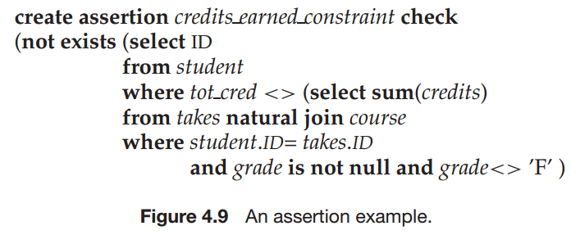
Assertion（断言）
An assertion is a predicate expressing a condition that we wish the database always to satisfy.

Slide 31
Index Creation
create table student (ID varchar (5), name varchar (20) not null, dept_name varchar (20), tot_cred numeric (3,0) default 0, primary key (ID))
create index studentID_index on student(ID)
Indices are data structures used to speed up access to records with specified values for index attributes
e.g. select * from student where ID = ‘12345’
can be executed by using the index to find the required record, without looking at all records of student
More on indices in Chapter 11

Slide 32
4.5 Built-in Data Types in SQL
date: Dates, containing a (4 digit) year, month and date
Example: date ‘2005-7-27’
time: Time of day, in hours, minutes and seconds.
Example: time ‘09:00:30’ time ‘09:00:30.75’
timestamp: date plus time of day
Example: timestamp ‘2005-7-27 09:00:30.75’
interval: period of time
Example: interval ‘1’ day
Subtracting a date/time/timestamp value from another gives an interval value
Interval values can be added to date/time/timestamp values

Slide 33
User-Defined Types
create type construct in SQL creates user-defined type
create type Dollars as numeric (12,2) final
create table department (dept_name varchar (20), building varchar (15), budget Dollars);

Slide 34
Domains
create domain construct in SQL-92 creates user-defined domain types
create domain person_name char(20) not null
Types and domains are similar. Domains can have constraints, such as not null, specified on them.
create domain degree_level varchar(10) constraint degree_level_test check (value in (’Bachelors’, ’Masters’, ’Doctorate’));

Slide 35
4.6 Authorization
Forms of authorization on parts of the database:
Read - allows reading, but not modification of data.
Insert - allows insertion of new data, but not modification of existing data.
Update - allows modification, but not deletion of data.
Delete - allows deletion of data.
Forms of authorization to modify the database schema
Index - allows creation and deletion of indices.
Resources - allows creation of new relations.
Alteration - allows addition or deletion of attributes in a relation.
Drop - allows deletion of relations.

Slide 36
Authorization Specification in SQL
The grant statement is used to confer authorization
grant <privilege list>
on <relation name or view name> to <user list>
<user list> is:
a user-id
public, which allows all valid users the privilege granted
A role (more on this later)
Granting a privilege on a view does not imply granting any privileges on the underlying relations.
The grantor of the privilege must already hold the privilege on the specified item (or be the database administrator).

Slide 37
Privileges in SQL
select: allows read access to relation,or the ability to query using the view
Example: grant users U₁, U₂, and U₃ select authorization on the instructor relation:
grant select on instructor to U₁, U₂, U₃
insert: the ability to insert tuples
update: the ability to update using the SQL update statement
delete: the ability to delete tuples.
all privileges: used as a short form for all the allowable privileges

Slide 38
Revoking Authorization in SQL
The revoke statement is used to revoke authorization.
revoke <privilege list>
on <relation name or view name> from <user list>
Example:
revoke select on branch from U₁, U₂, U₃
<privilege-list> may be all to revoke all privileges the revokee may hold.
If <revokee-list> includes public, all users lose the privilege except those granted it explicitly.
If the same privilege was granted twice to the same user by different grantees, the user may retain the privilege after the revocation.
All privileges that depend on the privilege being revoked are also revoked.

Slide 39
Roles
create role instructor;
grant instructor to Amit;
Privileges can be granted to roles:
grant select on takes to instructor;
Roles can be granted to users, as well as to other roles
create role teaching_assistant
grant teaching_assistant to instructor;
Instructor inherits all privileges of teaching_assistant
Chain of roles（Roles can be granted to users, as well as to other roles）
create role dean;
grant instructor to dean;
grant dean to Satoshi;

Slide 40
Authorization on Views
create view geo_instructor as (select * from instructor where dept_name = ’Geology’);
grant select on geo_instructor to geo_staff
Suppose that a geo_staff member issues
select * from geo_instructor;
What if
geo_staff does not have permissions on instructor?
creator of view did not have some permissions on instructor?

Slide 41
End of Chapter 4

